Slide 1
Building A Cognitive Assistant
With Watson Conversation and Node-RED
Chris Harrold
Technical Evangelist
January 24, 2018
© Copyright IBM Corporation 2018

Slide 2


Introduction
Focus / Passion
Transformation
Robots and IoT
Data (Architecture, Modeling, Integration)
Public Speaking and Teaching
Skills & Certifications
Data Science, AI, ML
Cloud, Docker, Splunk
Python, R, C, Node, Java/Javascript
Chris Harrold
Technical Evangelist, IBM
Proud Founder of the IBM WolfPack
@charrold303
charrold
team-wolfpack

Slide 3
What’s so great about Bots?
Node-RED quick intro
Let's Build!

Slide 4
Why Bots?

Slide 5
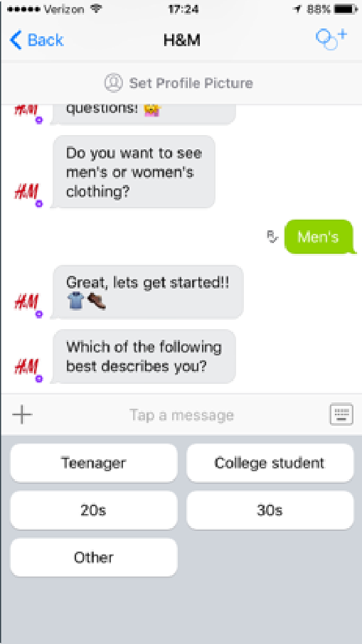
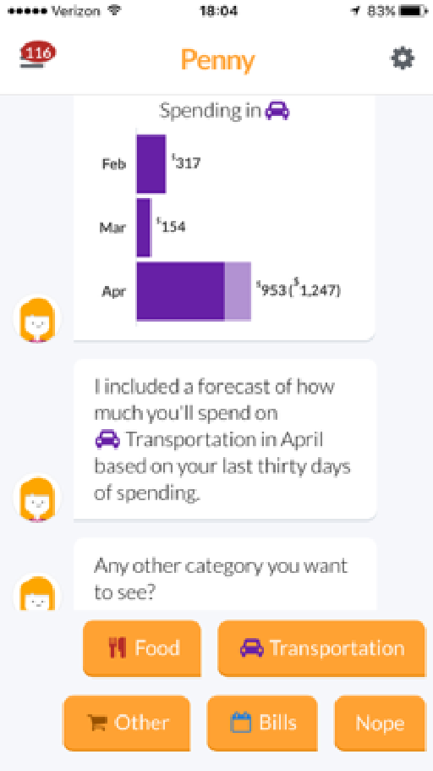
What’s a bot?
A “bot” can mean many things.
Let’s think of them
as conversational interfaces.

Slide 6









What’s a bot?
ELIZA
A bot psychotherapist
1950
1966
2000
TODAY
Alan Turing
Can machines think?
SmarterChild
AOL Instant Messenger

Slide 7
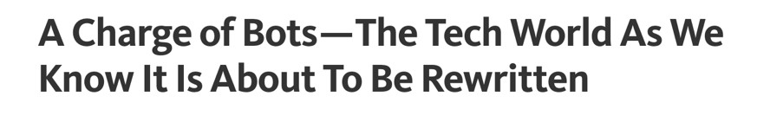
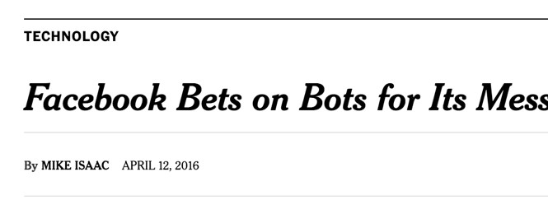
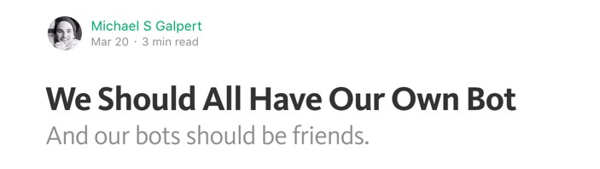
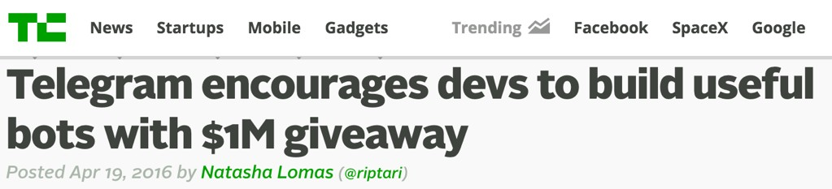
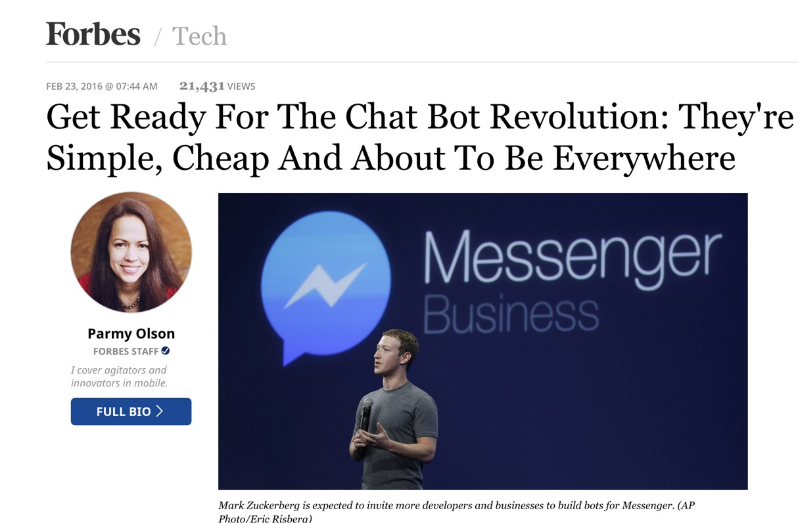
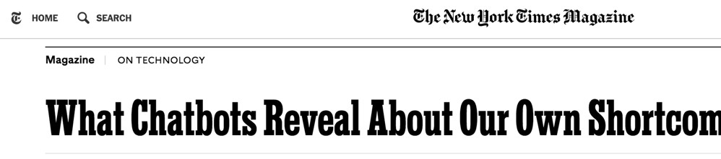
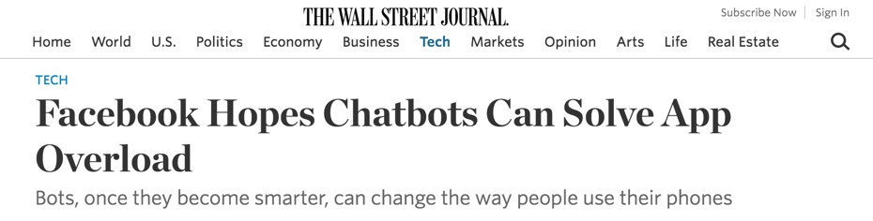
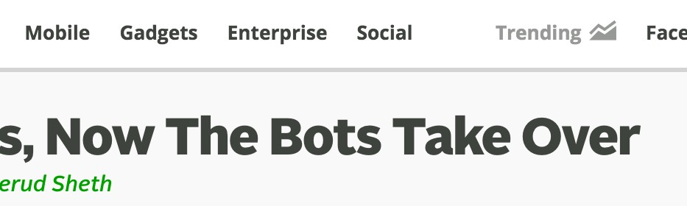
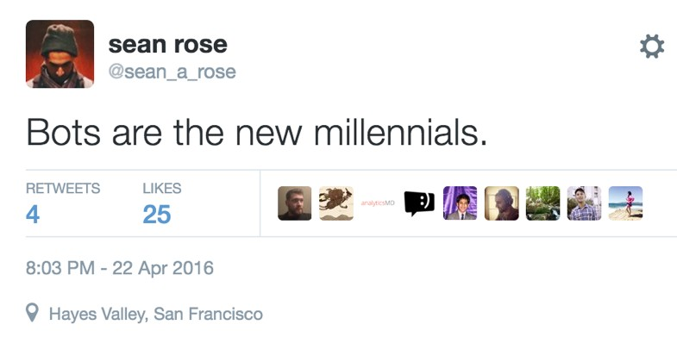
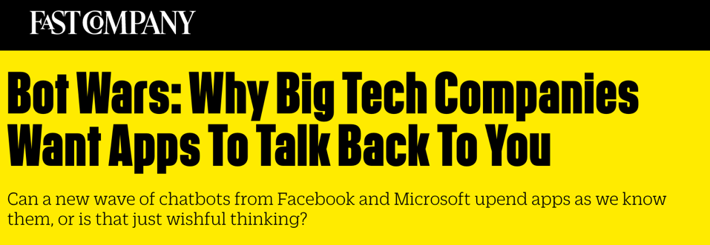
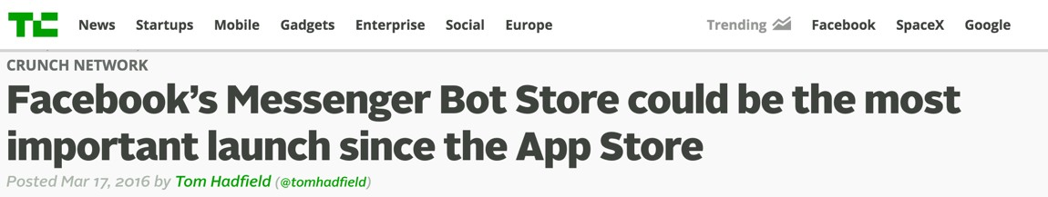
Bots are hot.
like, really hot

Slide 8
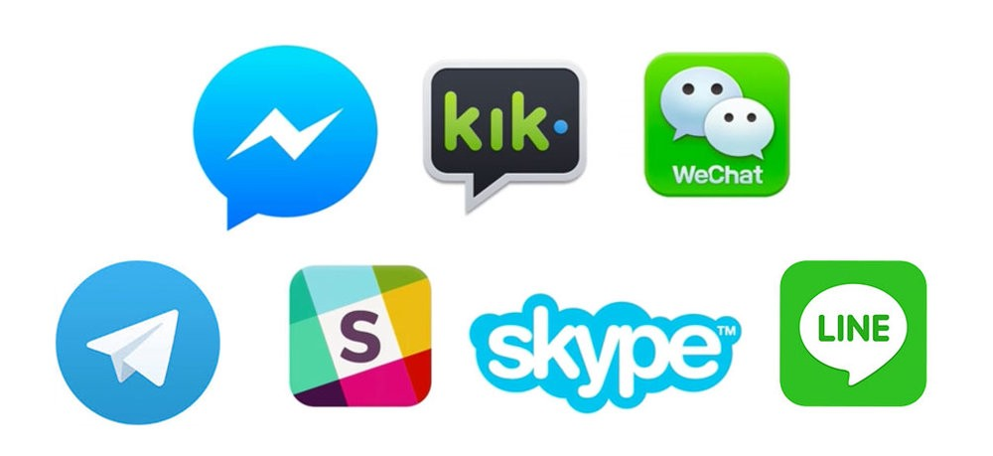



Why Bots?

Slide 9
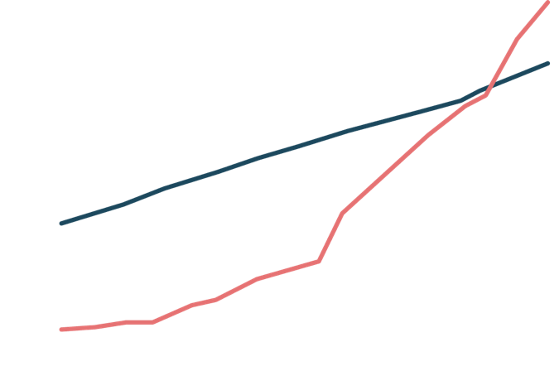
Bots By the Numbers
3bn MAU
0apps/
65.5% of smartphone
users download
2.5bn MAU
Usage of messaging apps has surpassed that of social networks
*via Business Insider
month

Slide 10
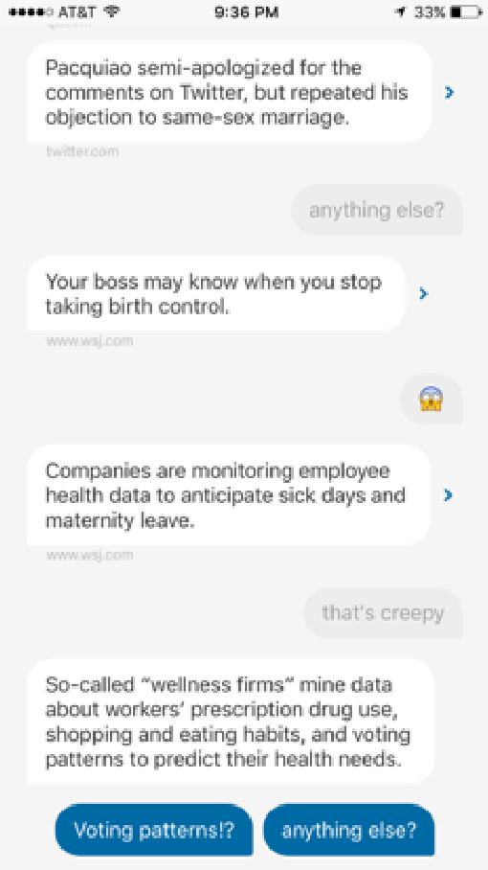
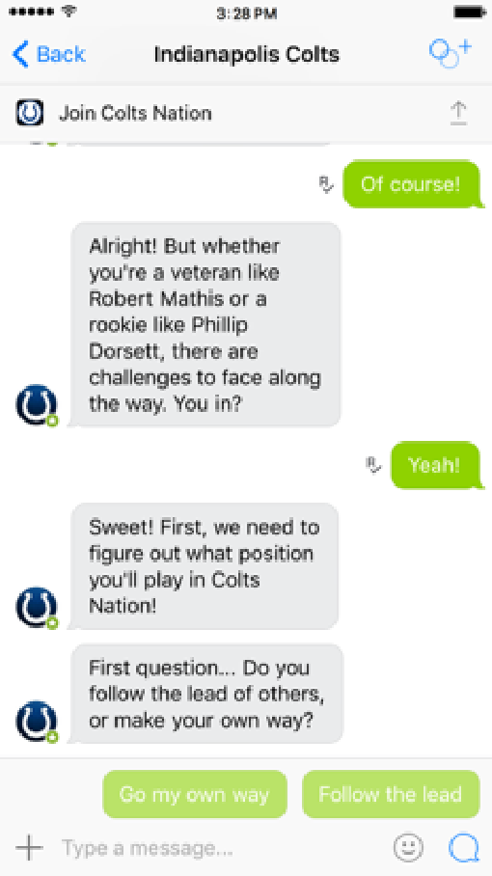
Key Use Cases
Information Retrieval & Customer Service
Transactional Processes
Sales and Marketing
Content Publishing & Advertising

Slide 11
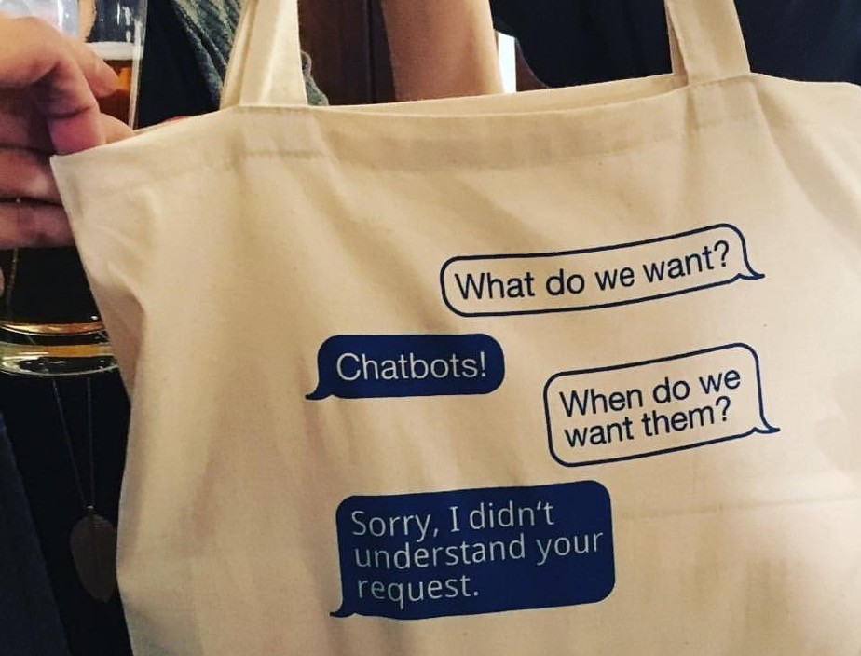
But then there’s this:

Slide 12

Key Takeaways
As NLP / AI continues to improve, the bot ecosystem will continue to expand
They’re good for SOME problems, but for those problems they’re REALLY good
Writers have a shiny new role
Can integrate into things users already use

Slide 13
Node-RED Intro

Slide 14
Node-RED
Node-RED is a visual tool originally designed for wiring the Internet of Things (IoT), but that can be used to create almost any type of programmatic workflow
Traditional development can be very technical, but Node-RED takes care of the technicalities and lets you concentrate on the logic of your workflow.
While most programming in Node-RED is done visually using pre-defined functions (“nodes”), any additional functionality can be added in almost any language with extensions and additional node types

Slide 15
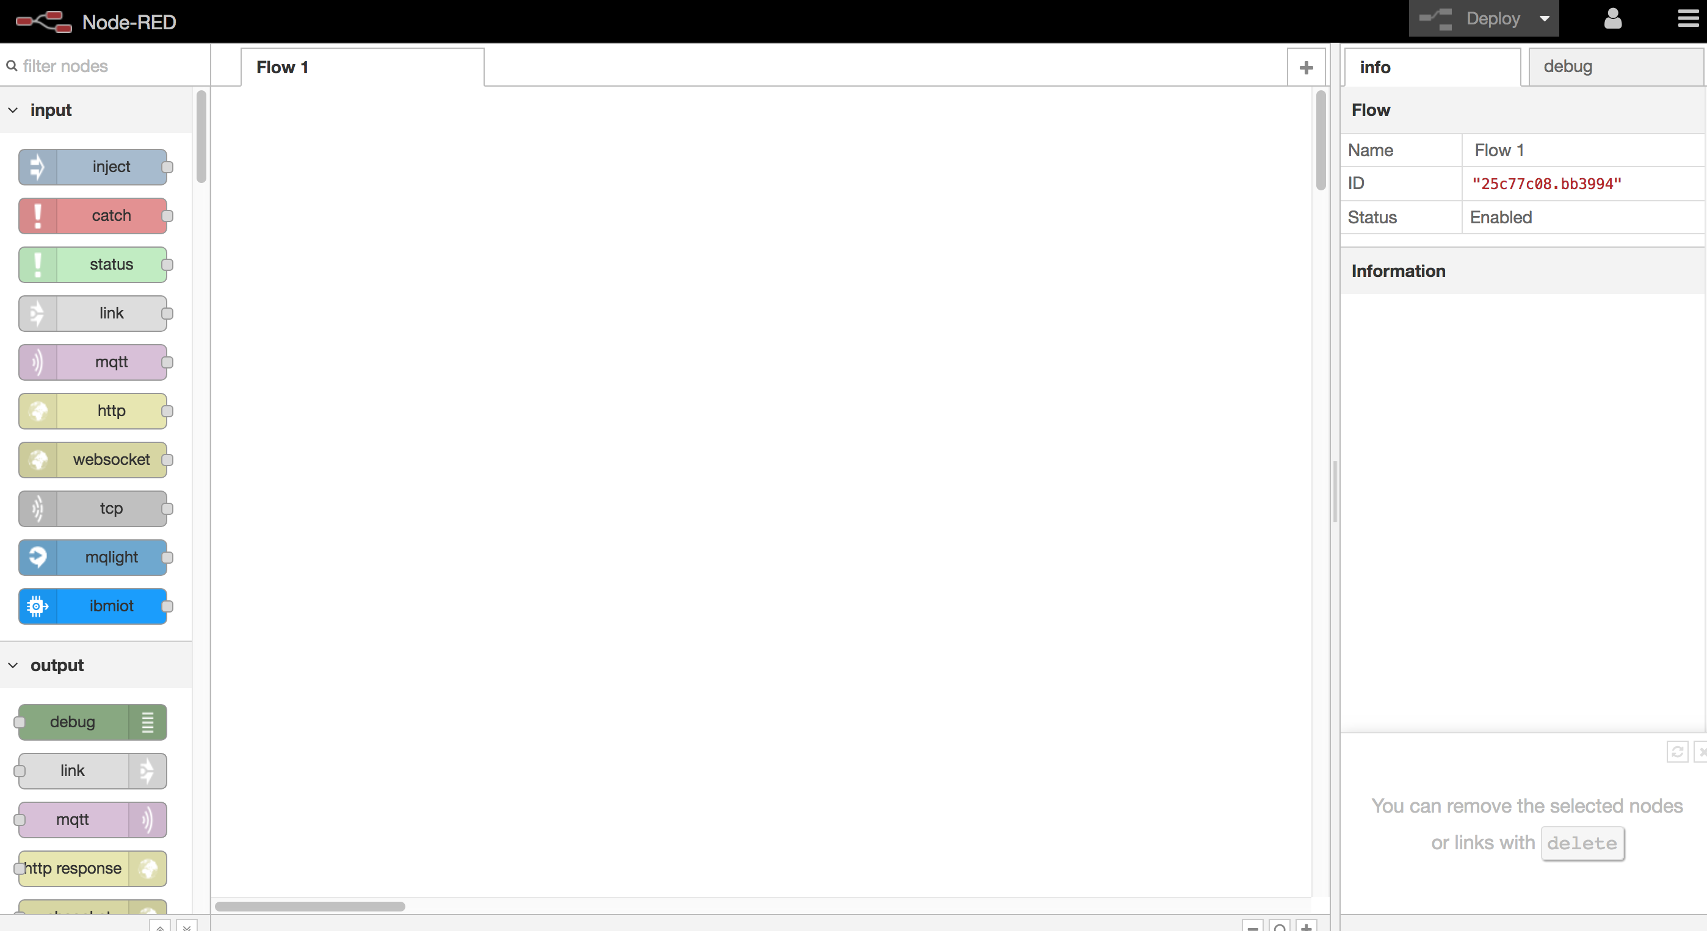
IBM’s Node-Red
Canvas
Nodes
Info and Debug

Slide 16
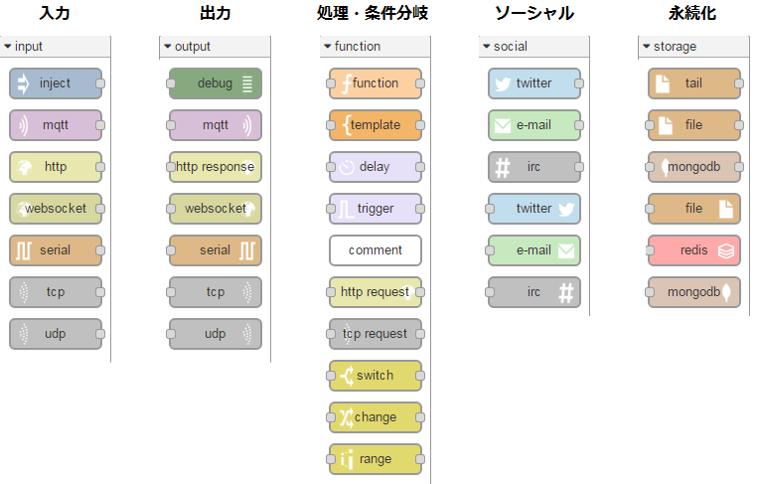
Nodes

Slide 17
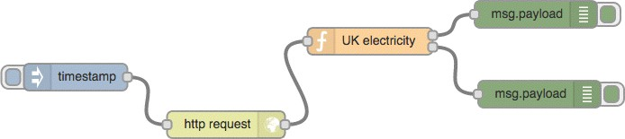
A Node-RED Flow
Defines a Workflow (“flow”)
Connects the steps of the process together (“nodes”) with “wires” that show the process steps

Slide 18
Let’s Get Building!

Slide 19

IBM WolfPack
IBM Technical Evangelists
Feedback for this session: http://bit.ly/DEN_12
Twitter: @IBMWolfPack
Git Hub Repo: team-wolfpack

